Slide 1
Real-Time Cryptocurrency Analysis System
LiangZhihao WangXue
2020 Jun -> July
Group 14

Slide 2
Outline
Background & Motivation
Objective
System Architecture
System Deployment Specification

Slide 3
Outline
Background & Motivation
Objective
System Architecture
System Deployment Specification

Slide 4
Background & Motivation
Sharp cryptocurrency market volatility
Social media opinion is a good indicator of market price
Real-time data explosion
Real-Time analyzation tool helps decision making

Slide 5
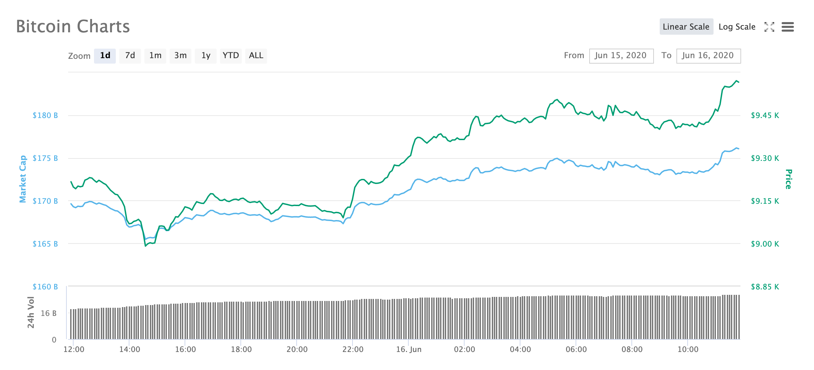
Sharp cryptocurrency market volatility
6.7%

Slide 6
Social media opinion is a good indicator of market price

Slide 7
Big Data Era
1 ZB = 1000⁷bytes = 10²¹bytes = 1000000000000000000000bytes

Slide 8
Real-Time Data Explosion

Slide 9
Outline
Background & Motivation
Objective
System Architecture
System Deployment Specification

Slide 10
Objective
Develop a cryptocurrency analyzation system that can handle massive amount of data in real-time.
High Throughput, Low Latency

Slide 11
Outline
Background & Motivation
Objective
System Architecture
System Deployment Specification

Slide 12
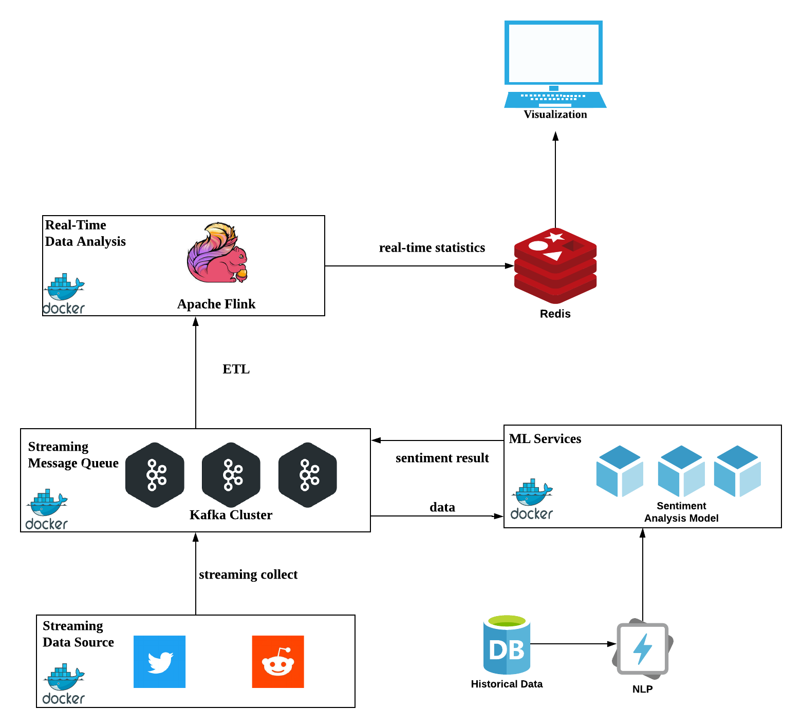
System Architecture

Slide 13
System Architecture

Slide 14
Outline
Background & Motivation
Objective
System Architecture
System Deployment Specification

Slide 15
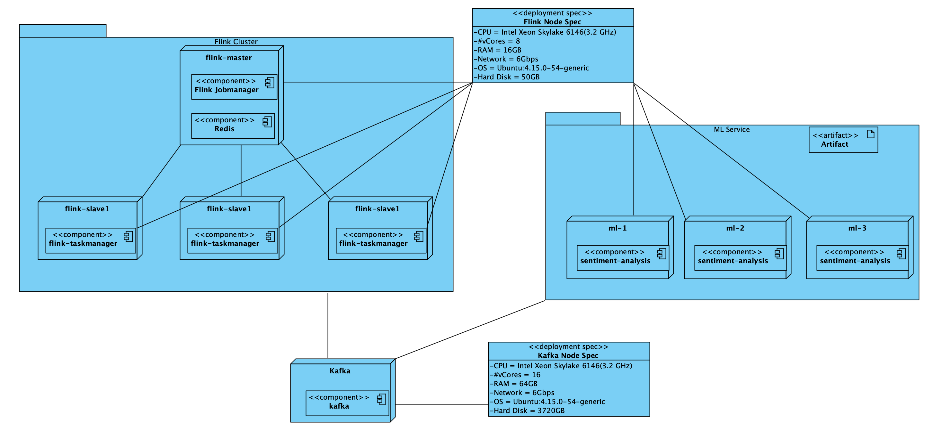
Deployment Diagram

Slide 16
Deployment Diagram
For easy deployment

Slide 17
Current Progress
Containerizing every subsystems using docker

Slide 18
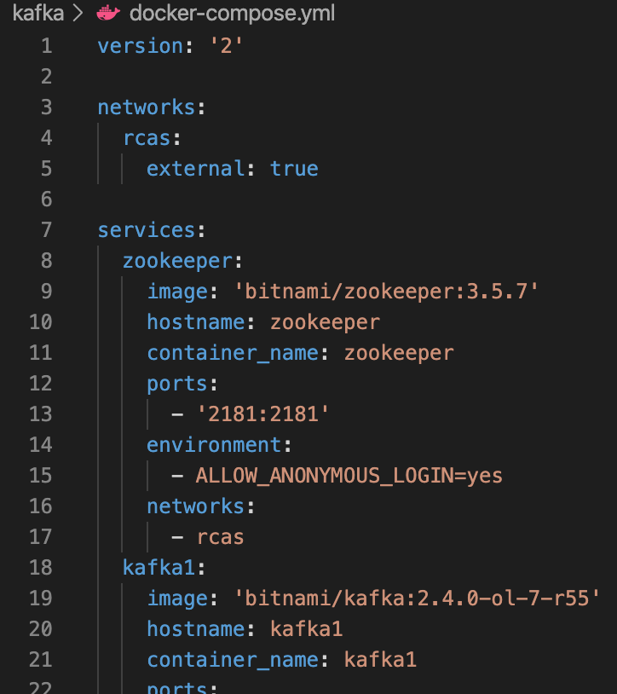
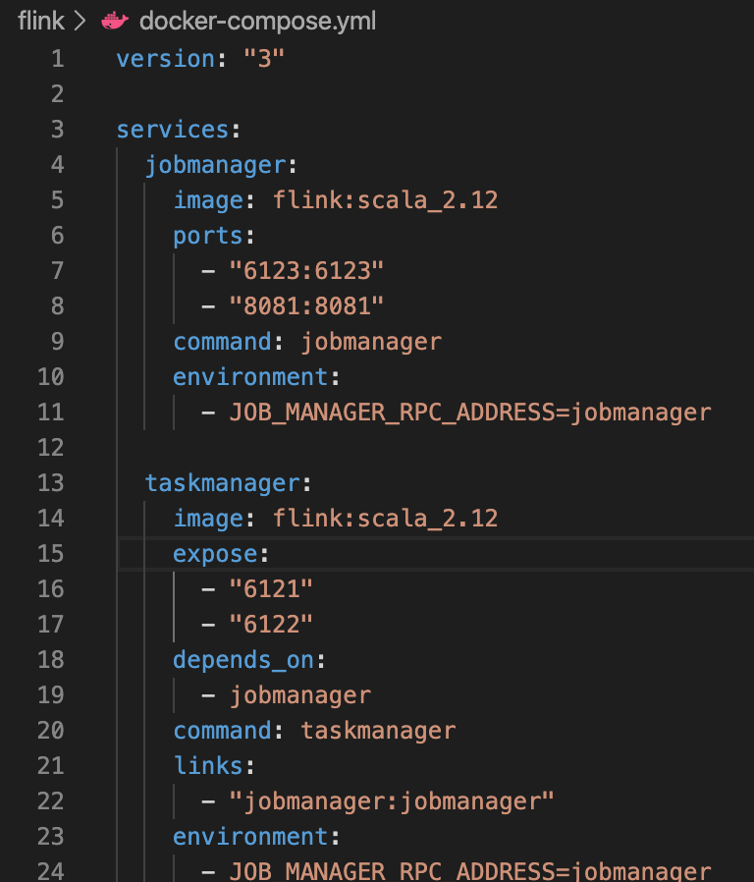
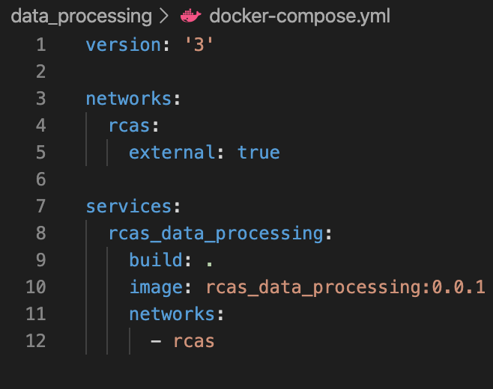
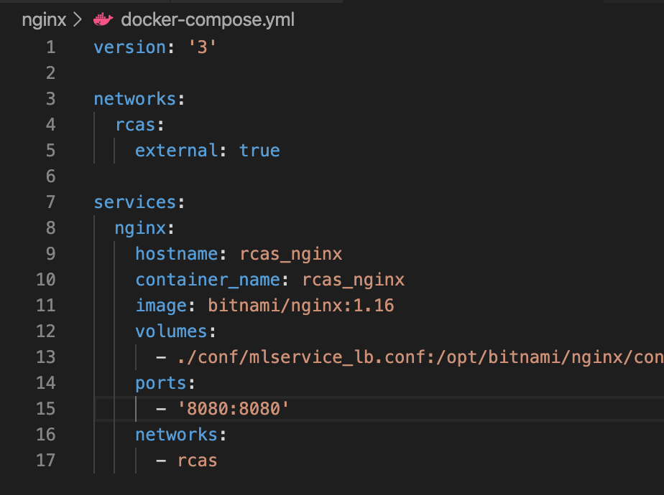
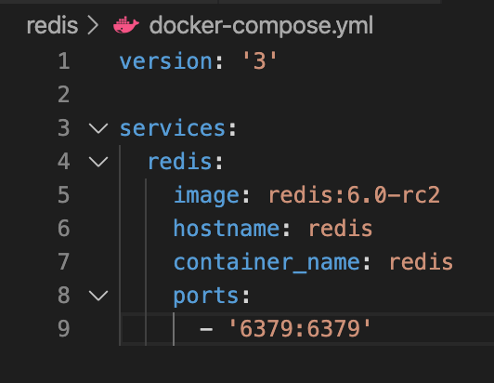
Current Progress
Containerizing every subsystems using docker

Slide 19
END

